Slide 1
iOS 9 – What is New? Nov 18
Jere Minich
Jminich@apcug.org
Program Chair, Lake-Sumter Computer Society
APCUG - Board of Advisors, Region 5

Slide 2
What This Presentation will Cover
Pros and Cons of IOS 9
What is contained in “Settings”
Major changes, not all changes
Multi-tasking new capabilities.
New Notes capabilities.
Under the Hood Refinements.
Extra tip & Tricks to keep your device at top speed.

Slide 3
The Good and the Bad
Pros
Lots of small, thoughtful design changes
Siri is more proactive
Spotlight search is deeper
New multitasking features for the iPad
Cons
Transit directions in Maps don't work everywhere
Apple News feels like a work in progress
No low-power mode for iPods, iPads

Slide 4
‘Settings’ in iOS 9
Every notable change ‘need to know’
The Settings app is where it happens.
Whenever you:
update iOS on your iPhone / iPad,
peruse the ‘settings’ app to find, enable, and configure any new features just to your liking.
The best addition is a:
‘Search box’ at the top of the main Settings menu.
Can’t remember where to enable Personal Hotspot or how to turn off shake-to-undo
Start typing in that ‘Search box’ to pinpoint exactly where your desired setting lives.

Slide 5
A rundown of the major changes in Settings in iOS 9
Cellular - SIM PIN
which used to be in the Phone settings
now is here in Cellular
Put a separate PIN code on SIM card.
Stolen or misplaced phone,
Couldn’t use your SIM card in another device.
iPhone / iPad will prompt - enter the SIM pin whenever you:
swap out the SIM
reboot the device
Subscriber Identity Module (SIM) Personal Identification Number (PIN)

Slide 6
SIM PIN is off by default
Want to change it, first you’ll turn it ON.
SIM has a default PIN on it already:
For AT&T and Verizon, it’s 1111
For Sprint and T-Mobile, it’s 1234
Get the number right within three tries or your SIM card will be locked
Use four digits
Use more,
up to eight digits total,
all numbers
Pick a code you can remember:
Enter the wrong PIN too many times
SIM will be permanently locked
Have to ask your carrier for a new one

Slide 7
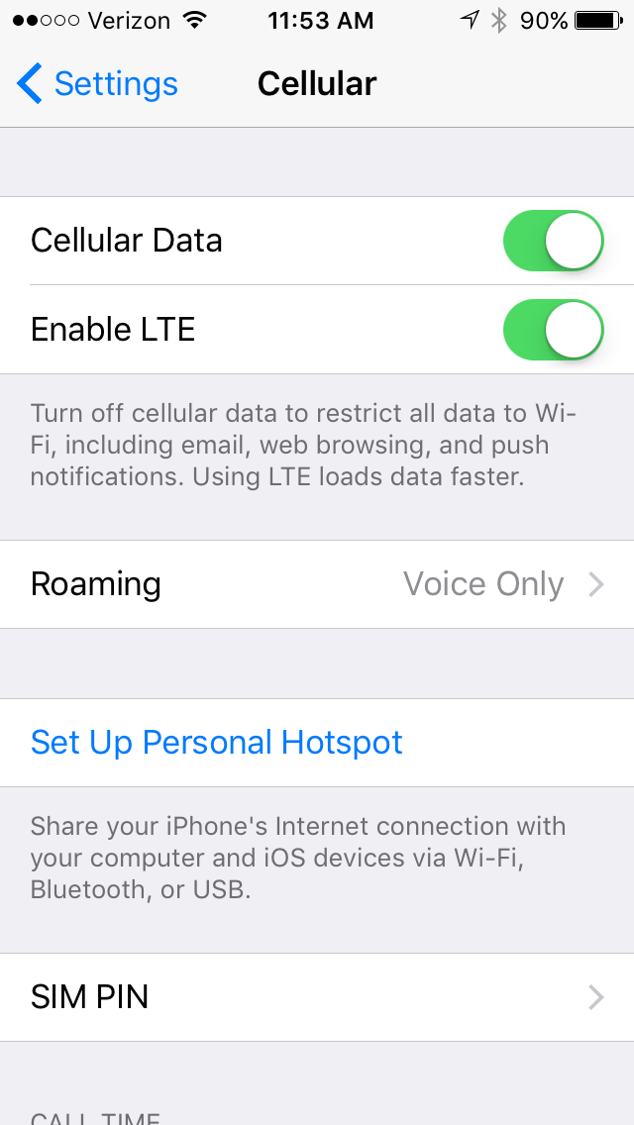
Note: This information applies only to devices that use a SIM card
Enable/Disable SIM PIN
From the Home screen, navigate: Settings > Cellular > SIM PIN.
Tap the SIM PIN switch to turn Switch ON (in the green position) or Switch Off.
Enter the current SIM PIN
Tap Done (located in the upper-right).
Note: The default SIM PIN is: (1111. Verizon & AT&T; 1234 Sprint & T-Mobile).
Modify SIM PIN
From the Home screen, navigate: Settings > Cellular > SIM PIN.
Ensure the SIM PIN switch is turned ON (in the green position).
Tap Change PIN.
Enter the current SIM PIN information
Tap Done.
Enter the new SIM PIN
Tap Done (located in the upper-right).
Re-enter the SIM PIN
Tap Done.

Slide 8
The other addition to this screen is Wi-Fi Assist
Located down below the huge list of apps
With toggles to allow them to use cellular data
Wi-Fi Assist ‘on’ by default
Use some of your cellular data to boost a poor Wi-Fi signal.
Wi-Fi network barely reaches every corner of your home
Might want to leave this on.
Use up your monthly data allotment every single month,
Might want to turn this off.
Fact: Wi-Fi Assist will switch to cellular data when the Wi-Fi signal is poor.

Slide 9
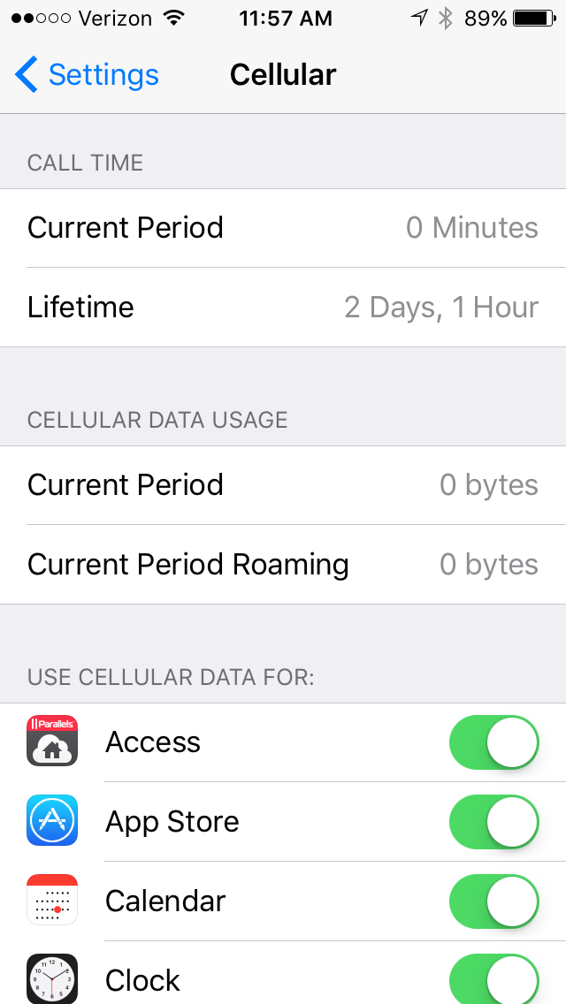
Manage iPhone cellular data usage: keep tabs on how much you are using
To view how much data you have used go to: 1. Settings > Cellular
2. Scroll down to see ‘Cellular Data Usage.’
Note: If you have never reset this number it could be pretty big.
Advice: get in the habit of resetting it every month.
Set an alert on your phone so that you remember to reset it on the day your network resets your allowance.
To reset your statistics:
1. Scroll down to the bottom of the page.
2. Tap: Reset Statistics.
Note: Get in the habit of looking here once in a while so you can see if you are on target.

Slide 10
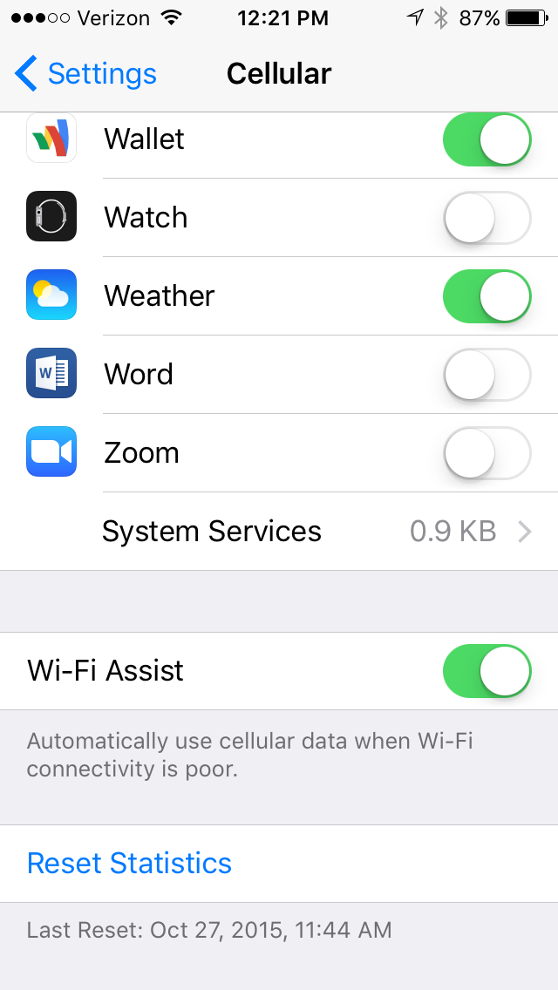
Manage Wi-Fi Assist
You can turn this feature off in:
1. Settings > Cellular
2. Scroll to the bottom of the page
3. Turn OFF Wi-Fi Assist
This feature is turned ON by default.
It can cause a battery drain.
It won’t work when you are data roaming in another country.
Not all apps can take advantage of the feature.
Apple’s Safari, Mail, Maps, and Apple Music do utilize the feature.

Slide 11
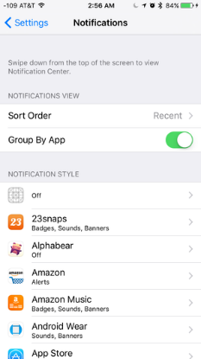
Notifications
A new sort order: Recent.
Select that - see the notifications in reverse chronological order;
the newest one is always on top.
Always want a certain app’s notifications on top:
Change Recent to Manual:
get a list of every app that sends notifications,
can slide them to preferred order, with Hamburger.
Note: Manual mode removes the ‘Group By App’ switch, since Manual grouping always groups your notifications by app.

Slide 12
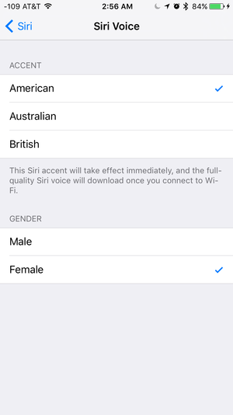
Siri Voice
Change Siri’s accent without having to change her language.
New Siri manifests - a friendly, multicolored waveform
(lifted from the Apple Watch)
that pulses and surges in response to your voice.
Siri is acting like a assistant with new ‘contextual smarts’.
Example: Ask SIRI to remind you of "this" while reading an article in Safari. Siri can:
figure out what you're looking at
create the appropriate event for whenever.
show photos from a specific time or location.
Siri quietly keeps tabs on what you're doing to get a sense of:
who you like to talk to,
what apps you like to use,
when you like to use them.
Siri learned to listen for your voice.
When iPhone is connected to a power source, you can get its attention with a quick "Hey Siri.“
iPhone 6s & 6s+ power source not required.
To set this up, follow the screen instruction so Siri can learn your voice.

Slide 13
Hey Siri
The line between ‘Siri’ and ‘Spotlight’ has started to blur.
App Developers can now let Spotlight peer into their apps and websites.
Can feed the same queries to both Siri and Spotlight:
along with things like basic math problems
and you'll get a quick answer too.

Slide 14
ProActive Assistant
Based on the:
apps you commonly use,
time of day you use them.
You will get intelligent suggestions for what you might want to do next:
even before you ask.
iOS 9 can:
automatically - what traffic looks like when you get in the car.
restart the podcast when you plug in your headphones.
tell who might be calling from an unknown number.

Slide 15
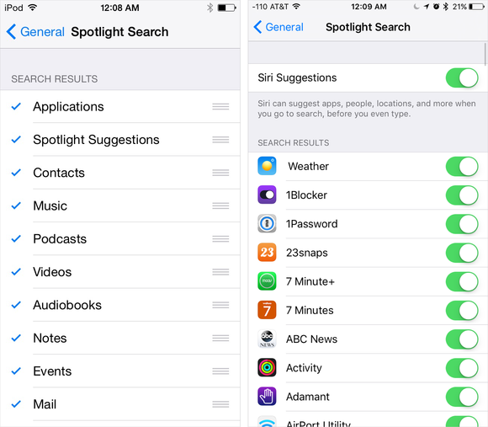
Spotlight Search
The top toggle on this screen is Siri Suggestions
Turn that on, and the Spotlight page will come pre-populated with suggestions before you even search for anything
‘Spotlight’ - search inside of apps as well as content like:
email
contacts
calendars
iOS 8
iOS 9

Slide 16
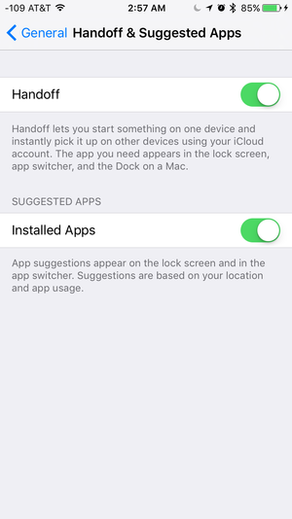
Handoff & Suggested Apps
Handoff - pass a task from one device to another
Example: starting an email on your iPad
and finishing on your iPhone/Mac
You can turn off this behavior here

Slide 17
Suggested Apps
Shown on the bottom-left corner of your lock .
in the app switcher mode, (double press home button)
based on your location or device usage patterns
Example: you are near a Target / Starbucks,
those apps’ icons will appear on your lock screen.
assuming you have the apps installed.
and have given them permission to access your location.
In iOS 9, this gets one switch, labelled “Installed Apps.”
only apps you have installed will show up here.
Not default apps supplied by Apple: (see list below)
iTunes Store, Music, Contacts, Notes, Clock, Game Center, FaceTime, Maps, App Store, News, Photos, Photo Booth, Videos, iBooks, Tips, Calendar, Camera, Messages, Mail, Settings, iCloud Drive, Find Phone, Podcasts, Find Friends, Reminders. (25 )

Slide 18
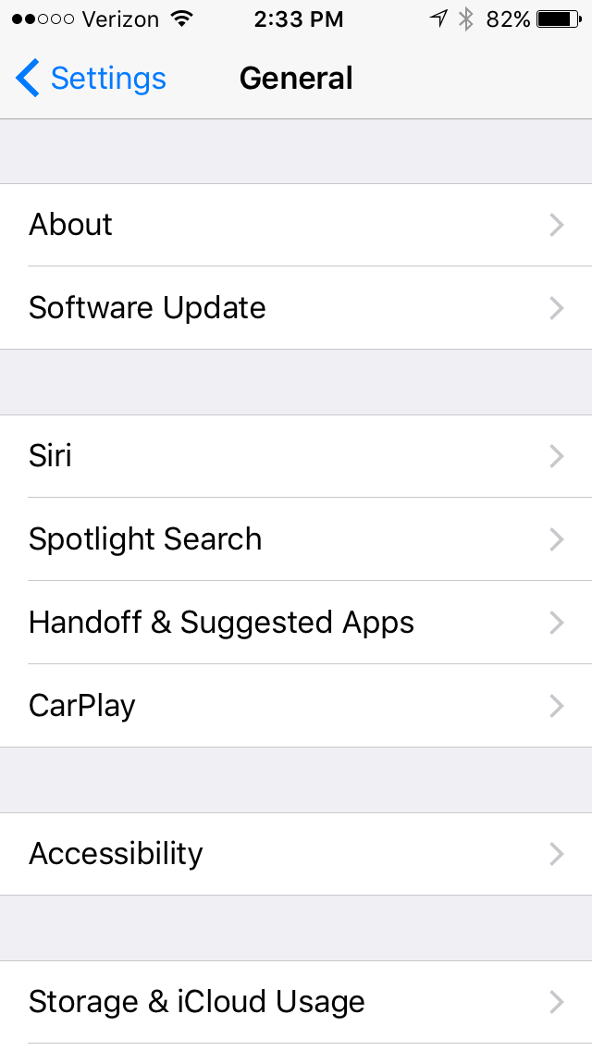
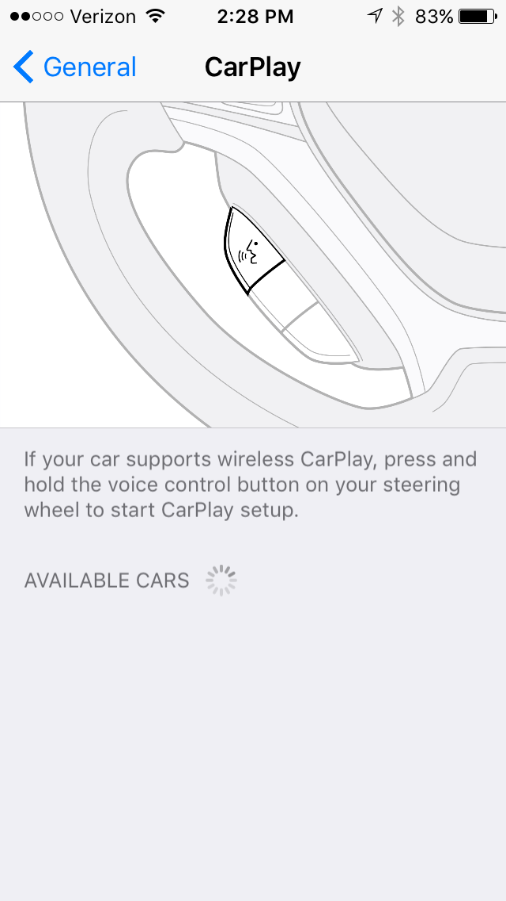
CarPlay
Supports wireless CarPlay connections
between your car and your iPhone.
designed to display:
information from the iPhone
on a car's built-in display,
giving drivers a safe way to:
make phone calls,
send text messages,
listen to music,
access Maps
all of the things a driver might want to do with an iPhone in a car.
iPhone only —no iPads or iPod touches.
Auto Steering Wheel

Slide 19
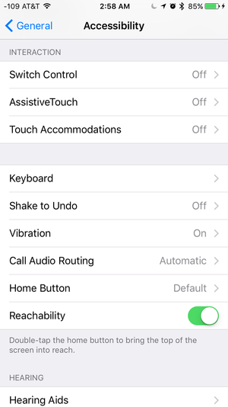
Accessibility
Quite a few small tweaks were made in:
General > Accessibility.
Touch Accommodations: This all-new menu tweaks behaviors like:
A. how long to touch the screen to register a tap-and-hold
B. duration in which multiple touches should only register as a single touch
Note: If your normal touches and swipes don’t always result in the intended action, some experimenting with these controls could really help.

Slide 20
The new Keyboard setting
“Show Lowercase Keys”:
means that your software keyboard will toggle between lower-case and upper-case letters.
always tell what kind of letter you’re about to type.
Turn this switch off to keep the old ‘always-capital’ keyboard.

Slide 21
Shake to Undo; Vibration
Shake to Undo:
turn off the shake-to-undo feature here.
Brings back emails just deleted by mistake.
Vibration:
turn off all vibration on your device,
including those for emergency alerts.

Slide 22
Restrictions
This is where you can restrict certain things:
Don’t want a user to:
have access to Safari (the internet)
be able to install new apps
make in-app purchases
Two notable options here include switches to:
disable Apple Music Connect
the new News app.
If you hate apps asking you if they can connect to Facebook, go to Restrictions > Facebook, and tap Don’t Allow Changes.
Restrictions - eliminates the App icon from the home screen.

Slide 23
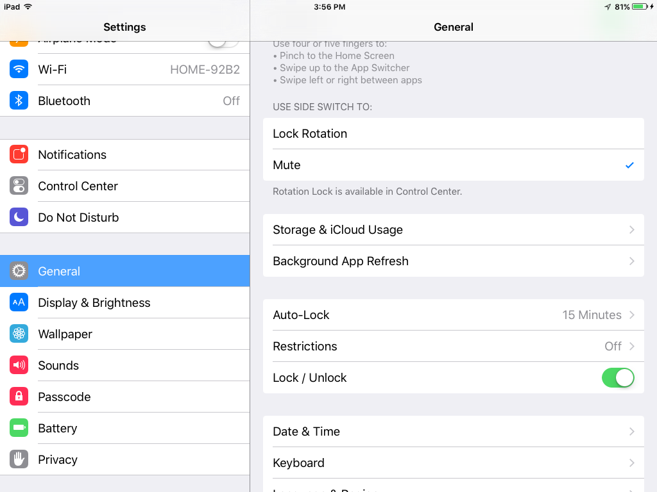

Slide 24
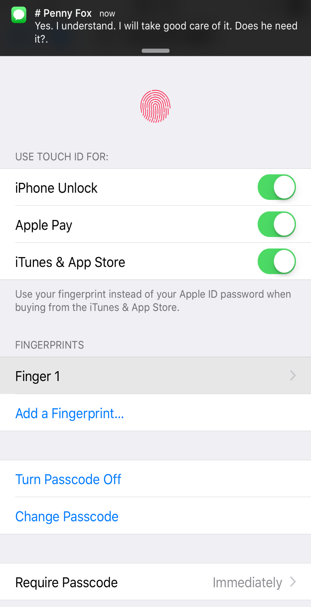
Touch ID & Passcode
A couple of new switches to allow access to:
the Wallet app (formerly Passbook)
Reply With Message from the lock screen.
iPad Passcode Display on next slide
This is a iPhone Display

Slide 25
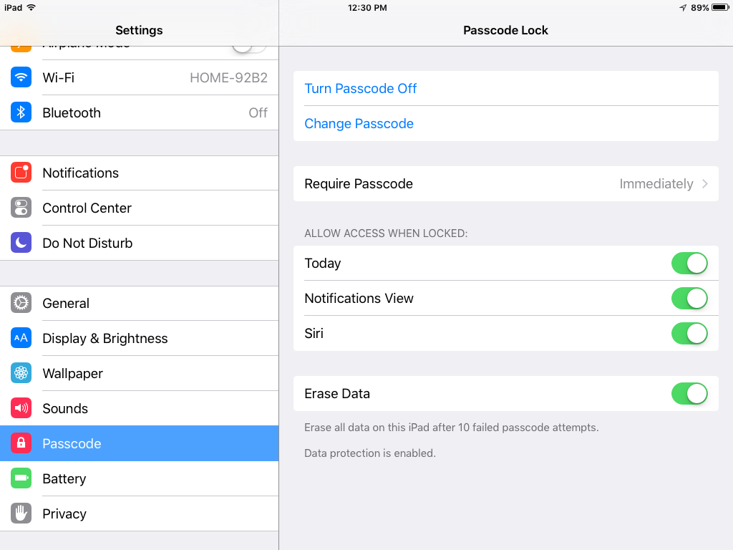
This is an iPad Display with out Cellular

Slide 26
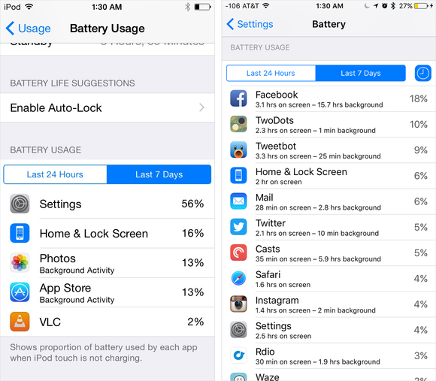
Battery
The all-new Battery menu
manually enable Low Power Mode.
Device will also offer to go into Low Power Mode when:
reach 20 percent battery remaining,
again at 10 percent.
See which apps have been gobbling up the most of your battery life, by percentage.
iOS 9 has a new little clock icon;
tap it
see how much time each app has been running,
both on your screen
in the background.
iOS 8 Display
iOS 9 Display

Slide 27
Mail, Contacts, Calendars
Scroll down to the Contacts section for a new switch:
“Contacts Found in Mail”
This is ON by default
It lets your iPhone scan your email
(on the device, not sending it up to the cloud)
looking for contact information like phone numbers and email addresses.
That way, it can suggest:
auto-complete addresses in Mail
make an educated guess on the incoming-call screen as to who’s calling you
if that name and number aren’t in your Contacts list yet but are stashed in your email.
If you don’t want this to happen, turn this switch OFF
Another step in tying your contacts together.

Slide 28
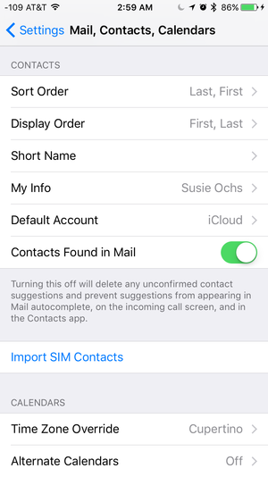
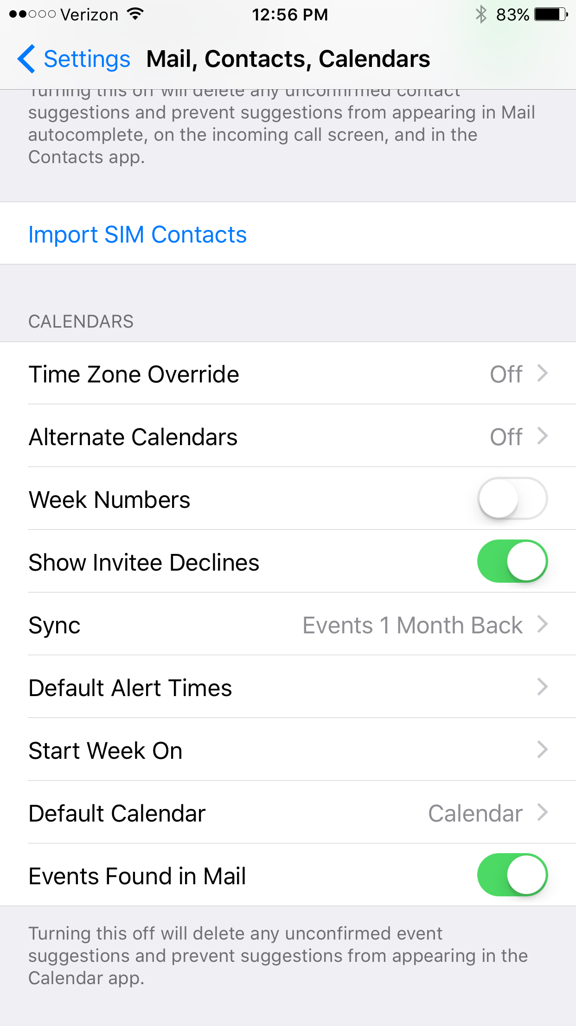
This lets the Mail app:
sniff out events mentioned in email
offer to add them to your calendar.
In Both iPad & iPhone
ON by Default
iPhones Only
ON by Default

Slide 29
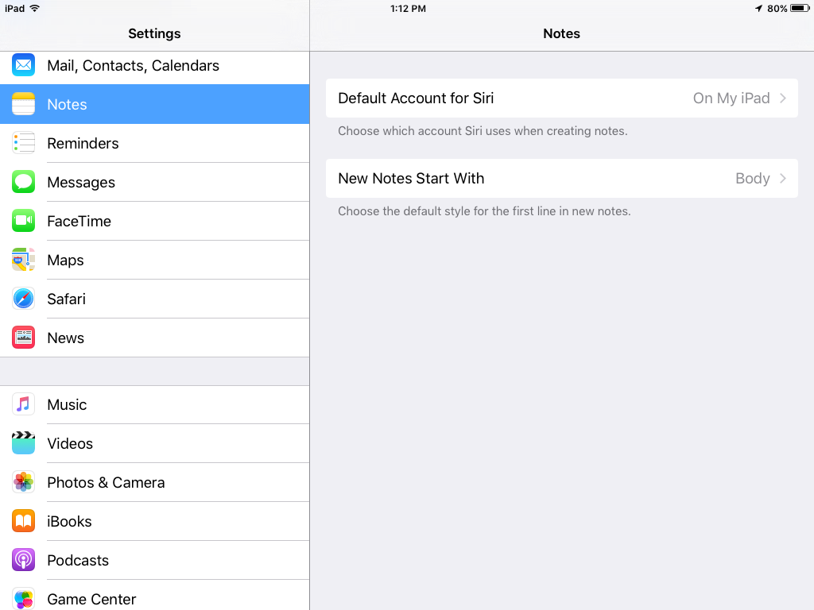
Notes
Tap here and see next Slide for results.
New Notes settings specify:
Which account Siri will use when you dictate a note,
Which field to start new notes with by default:
Title, Heading, or Body.

Slide 30
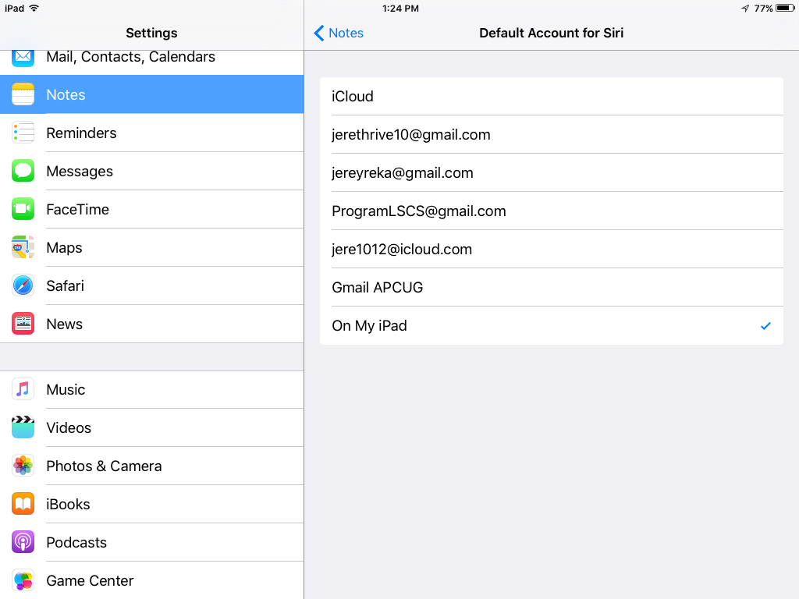
Use SIRI to takes NOTES, where do you want the notes to be attached.
You ‘Tap’ to set the check mark.

Slide 31
How to use multi-touch gestures Multitasking
Quickly perform routine tasks without relying on the bottom ‘Home button’.
To activate: Settings -> General> Gestures ON/OFF switch.
Pinch to the Home Screen –instead of pressing the home button to access the home screen from within any app:
A. Place 4 or 5 fingers spread out on the screen, and pinch together.

Slide 32
Multitasking
2. Swipe Up to Multitasking –Use instead of pressing the home button twice.
A. Place 4 or 5 fingers spread out on the screen, and move your hand upward.
3. Swipe Left or Right Between Apps –This allows quick movement between applications that are currently running.
A. With App running, place 4 or 5 fingers spread out on the screen,
B. Move your hand to the left to switch to the last opened App.
C. With the same motion, move your hand back to the right to switch back to the previous App.
NOTE: The key is 4 or 5 Fingers

Slide 33
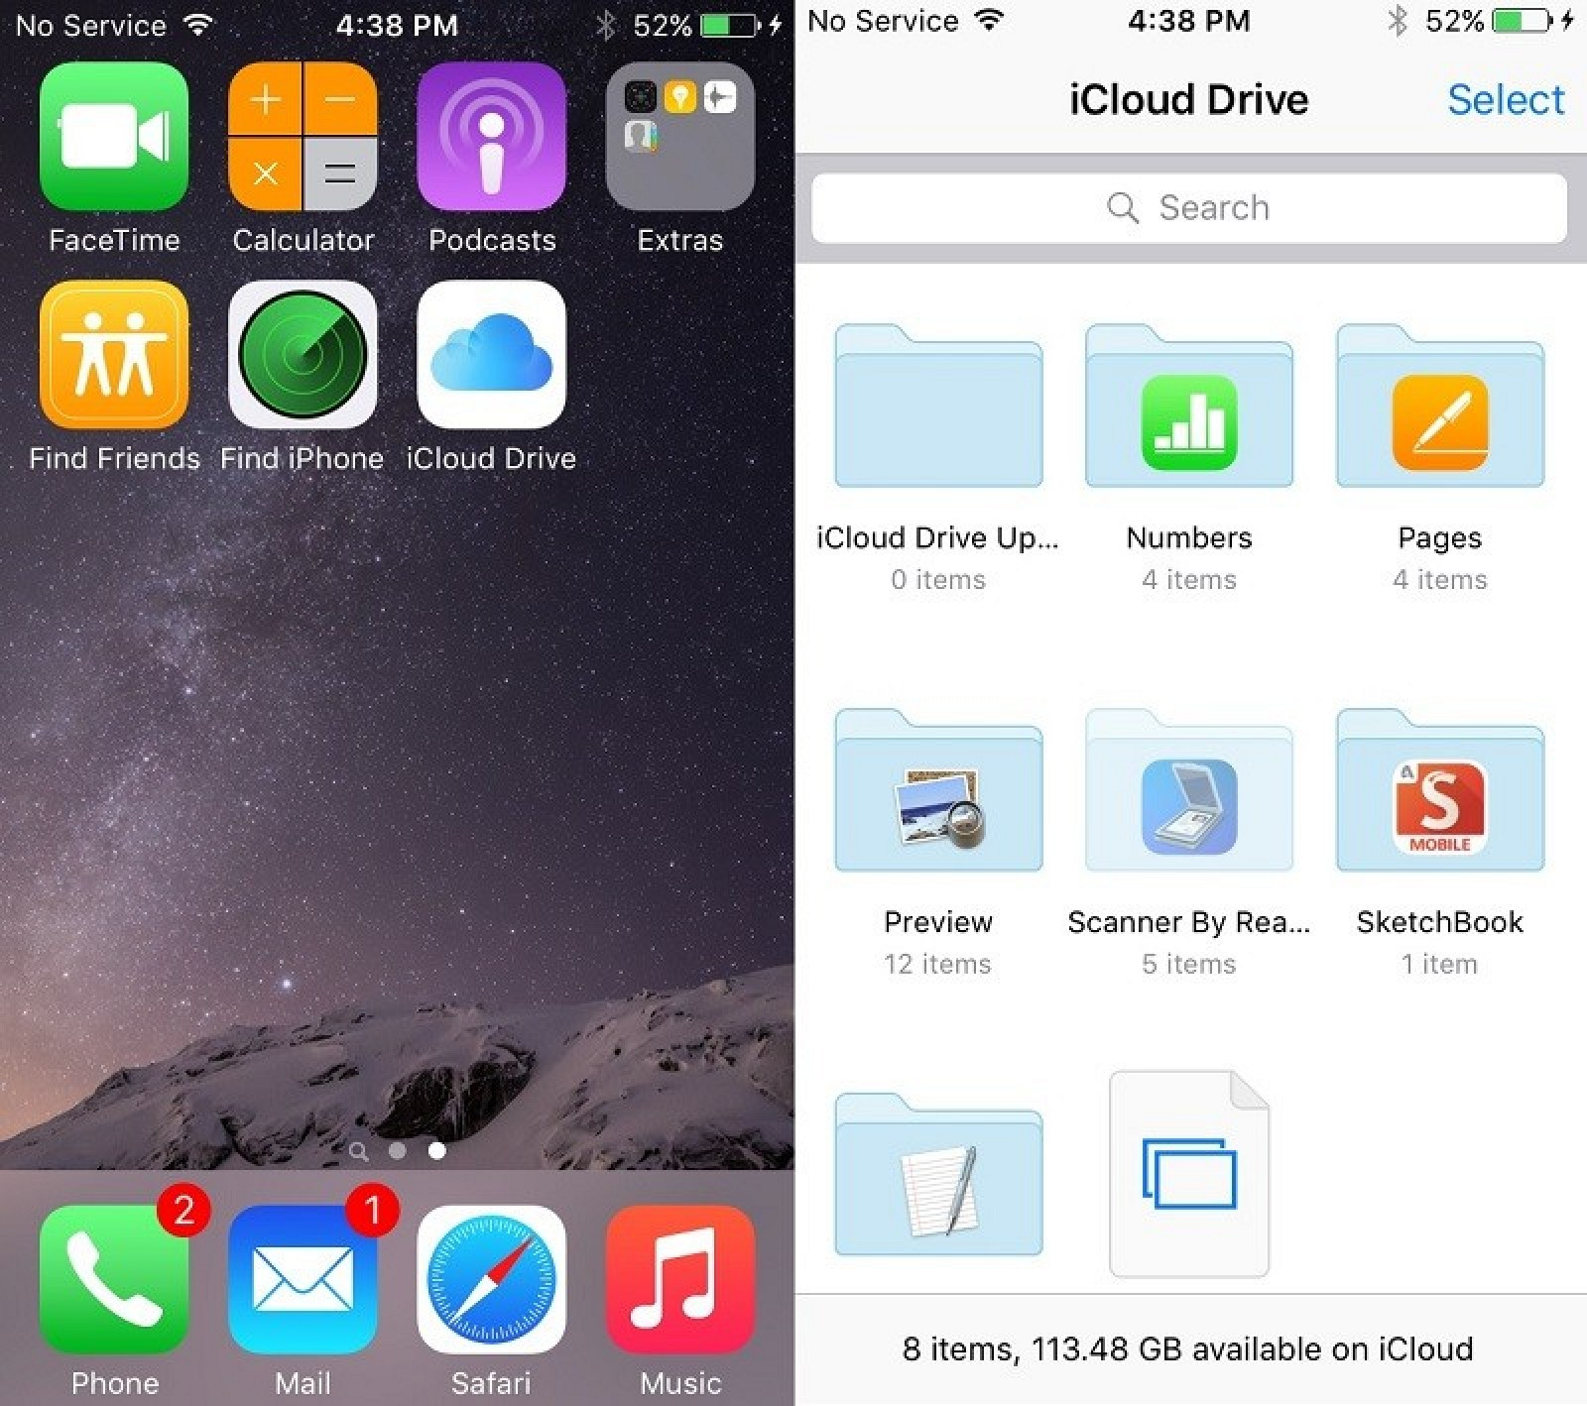
iCloud Drive
An optional “iCloud Drive” App that can be installed through the “iCloud” section of the Settings App.
The iCloud Drive App lets you:
see,
access,
manage,
all of the files stored within iCloud Drive.

Slide 34
News and Notes
Start off by selecting a few topics and channels that interest you.
Let ‘News’ know what you like, you’ll have access to a customized stream of stories from top news organizations and indie publications.
Note: Indie pub = A publisher with annual sales below a certain level.
News App.
Now you can add:
photos,
maps,
web links, etc.,
Directly to your notes.
Turn a list into a checklist with a ‘tap’.
Changes to your notes will be updated across all your devices and on iCloud.com.
Now you can take a photo from within the Notes app.
Or tap to access your photo library and add an existing photo or video to a note.
Notes App.

Slide 35
New Notes
Turn lists into checklists.
Add bullets with a ‘tap’ to create checklists.
Make a:
grocery list,
wish list,
to-do list
Check off items as you go.
Sketch your thoughts.
Use the tip of your finger to draw right in your note.
A selection of drawing tools lets you choose different:
brush styles
colors.
A handy ruler helps you keep things straight.

Slide 36
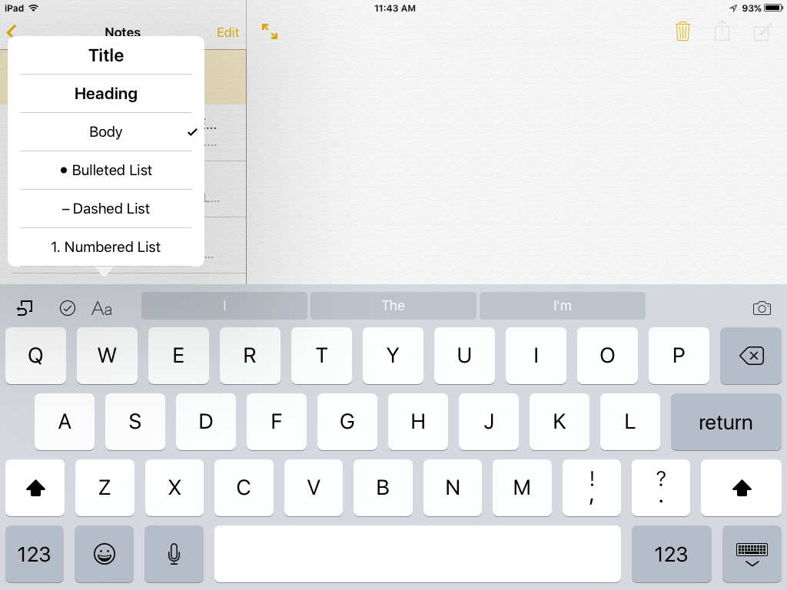
New Notes
iPad w/o 3D Touch
Tap any of these icons to get:
Previous note added.
Check List started
where to put the notes:

Slide 37
To open the new formatting toolbar:
Tap the “+” button within each note.

Slide 38
Adding to Notes
Add to notes from whatever App you’re using.
Tap the ‘Share’ button in:
Safari
Maps
Lots of other Apps.
To save attachments like:
maps, links, Pages, documents.
To add to a new or existing note.
Update Older Notes
Launching ‘Notes’ for the first time in iOS 9:
you will be prompted to update your notes stored in iCloud to the new version.
Once you update, you’ll be able to access notes on your Mac or other devices;
only when they’ve been upgraded

Slide 39
Attachments Browser
An additional view to browse:
all attachments saved across all folders.
Accessed by tapping the ‘grid’ icon in the bottom left corner of the notes sidebar.
The Attachments Browser lets you view a cluster of:
photos and videos
Sketches that you made
websites
audio clips
documents in a single screen

Slide 40
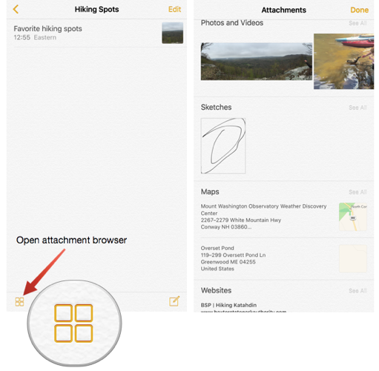
Attachments Browser
Organizes all the items attached to ‘Notes’ in one simple view.
To find what you’re looking for.
Don’t have to open a handful of ‘Notes” to find that receipt you attached a note last month.
How to get it Done:
1. Tap the ‘Attachments Browser’ icon.
2. Look through the thumbnails to find the content needed.

Slide 41
Add Maps, URLs, and other Content to Notes
Notes has a sharing extension.
It allows adding content to a ‘Note’ with just a few taps.
Example: you can add a:
URL from Safari,
link to Map
Pages document
to any ‘Note’. \
1. Select the Share button while you are working in an App.
2. Select the ‘Notes’ extension to save the attachment to a new or existing ‘Note’.

Slide 42
Under-the-hood refinements
Even longer battery life.
Apps and key technologies have been made more efficient to trim battery usage.
You get more battery life for the things you do every day.
Thanks to ambient light and proximity sensors, your iPhone knows if it’s facedown on the table.
New Low Power mode lets you extend your battery life even further.
Smaller, more convenient updates.
New updates to your device will be smaller in the future. (iOS 9 = 1.3GB: iOS 8 = 4.58GB)
Which means you don’t need as much free space to update iOS.
And when it’s time for an update, you’ll get new notification options that let your device update while you sleep or when you use it least.
Faster and more responsive.
The apps now take advantage of Metal cooling effect;
efficient use of the CPU and GPU to deliver:
faster scrolling, smoother animation, better overall performance.
Email, imessages, web pages, PDFs (render faster)
Multitasking features on iPad feel fluid and natural.

Slide 43
Under-the-hood refinements (cont’d)
Improved security.
Keeping your devices and Apple ID secure
essential to protecting your personal information.
Advanced security by strengthening the passcode.
Six-digit passcodes
The default for passcodes on your Touch ID -If you use Touch ID, it’s a change you’ll hardly notice.
enabled iPhone and iPad is now six digits instead of four.
one million possible combinations — instead of 10,000
Two-factor authentication
A password alone is not always enough to keep your account secure.
Built-in support for two-factor authentication.
Once enrolled, any time you sign in from a new device or browser,
you’ll be prompted for a verification code.
This code is automatically displayed on your other Apple devices or sent to your phone.
Enter the code and you’re quickly signed in.
Any unauthorized users are kept out.

Slide 44
The Final Word
Not all iOS 9- 9.1 updates were covered.
Some New Features are only for iPad or only for iPhone
Some New Features required addition upgrading or Apps.
Not all devices can handle all the New Features.
iOS 9 is compatible with these devices. (If you are running iOS 8)
iPhone ; iPhone 6s, 6s Plus; iPhone 6; 6 Plus; iPhone 5s, 5c, 5; iPhone 4s;
iPad: iPad Pro; iPad Air 2; iPad Air; iPad 4th,3rd, 2 generation; iPad mini 4,3,2
This Website gives additional Information
http://www.apple.com/ios/whats-new/

Slide 45
End
The
Jere Minich
Jminich@apcug.org

Slide 46
Extra - Speed Up iOS 9 by:
Disabling Transparency & Motion
Disabling transparency (eye candy)can speed up the general interactivity.
Open the “Settings” app
Go to: General > Accessibility > Increase Contrast > Reduce Transparency.
Tap that to the ‘ON’ position

Slide 47
Extra - Speed Up iOS 9 by: Reduce Motion
Disabling motion (eye candy) can speed up the general interactivity.
1. Open the “Settings” app.
2. Go to: General > Accessibility > Reduce Motion.
3. Tap that to the ‘ON’ position.

Slide 48
Extra - Boost Performance By Disabling ‘Background App Refresh’
1. Open the “Settings” app,
2. Go to: General > Background App Refresh.
3. Tap to turn the feature to the ‘OFF’ position.

Slide 49
Extra - Disable ‘Spotlight Search’ for Another Speed Increase
It also slows down iOS (at least on some hardware), and turning it off has an immediately noticeable increase in speed.
1. Open the “Settings” app.
2. Go to: General > Spotlight Search.
3. Tap the switch for “Spotlight Suggestions” to the ‘OFF’ position.

Slide 50
Safari for iPhone & iPad running slow? Here's how to speed it up!
1. Open the ‘Settings’ app.
2. Go to: Safari > Scroll down - Clear History and Website Data.
3. Tap on ‘Clear’
4. On the pop-up Tap ‘Clear History and Data’.

Slide 51
Bonus Tip: Forcibly Reboot the Device
Forcing the device to reboot can help performance,
usually if there is an errant process or something of the like going on in the background.
force rebooting is easy to do:
1. Hold down the Home button and Power (wake/sleep) button until you see the  Apple logo on the screen.
2. Release both buttons.
3. Wait for the device to come back up.

