Slide 1
APCUG An International Association of Technology & Computer User Group
Jere Minich
Board of Advisors Rep. Region 5 = FL, GA, LA, SC
www.apcug2.org
www.facebook.com/APCUG
www.twitter.com/apcug
www.youtube.com/apcugvideos
jminich@apcug.org

Slide 2
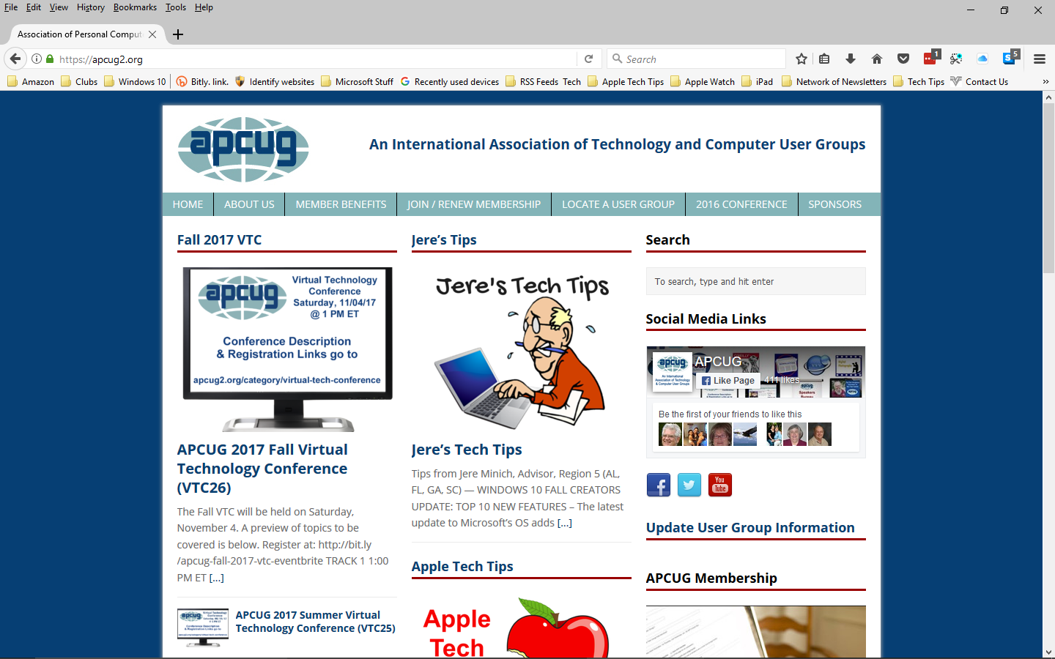

Slide 3
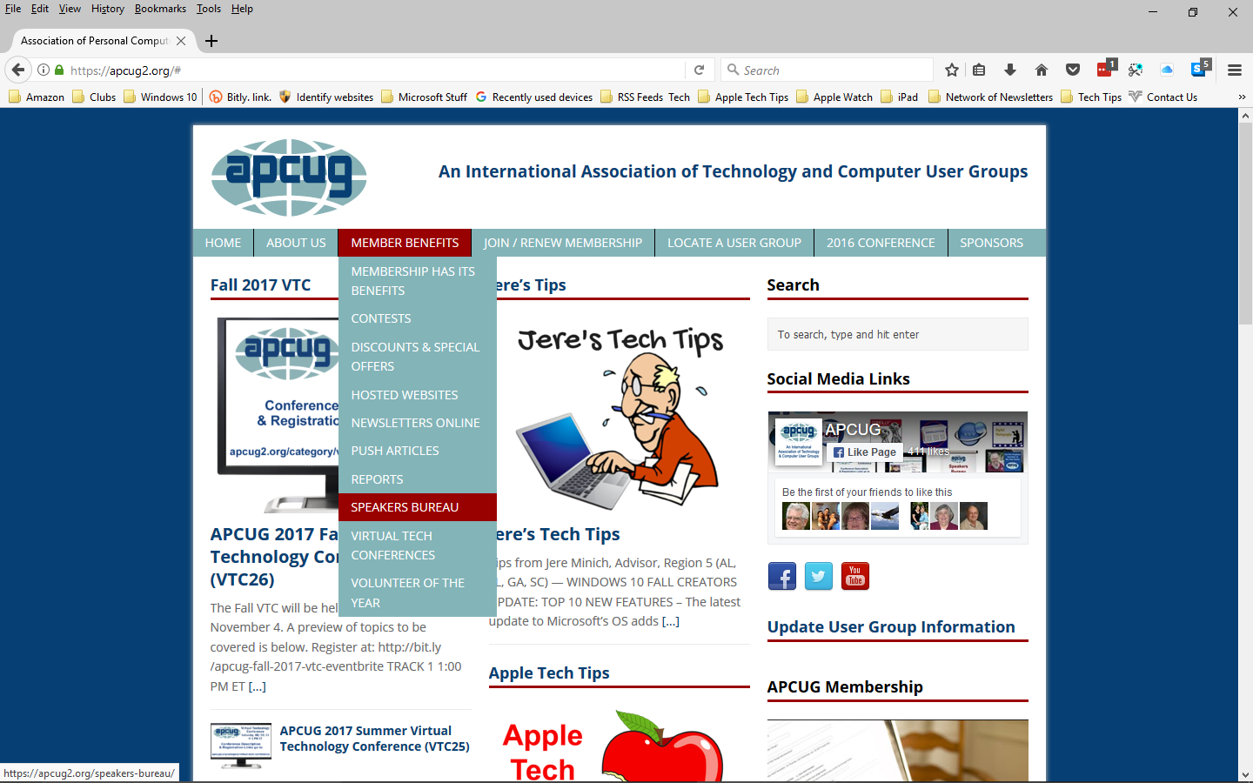

Slide 4
What can APCUG do for my Computer Users Group? (CUG)
Maintains a list of Vendors /User Group officers & members who will:
give online presentations to your group.
Virtual Technology Conference (VTC) quarterly.
videos of past sessions at APCUG’s
YouTube channel: www.youtube.com/apcugvideos
Newsletters from APCUG-member groups for:
Articles, Program Ideas, Fundraising
Information regarding:
vendor discounts, special offers
Host your Group website.
Emails and assistance from your Region Advisor.

Slide 5
Contact a Speaker, set up a SKYPE presentation.

Slide 6
What Can APCUG do for Each member of a CUG?
Virtual Technology Conferences – Free Online Presentations APCUG offers a Virtual Technology Conference quarterly.
Next VTC = Feb. 1, 2017 – 1PM Start time.
PUSH Newsletter Articles -Articles are sent to User Group editors to use in their User Group newsletters.
APCUG’s YouTube channel: www.youtube.com/apcugvideos.
over 100 - 50 minute presentations. Watch or Download.
UGLS – Neighbors to Help Out: Check out your state/country in the UGLS (User Group Locator Service),
there are probably several groups within a 200-mile radius of your User Group or current location.

Slide 7
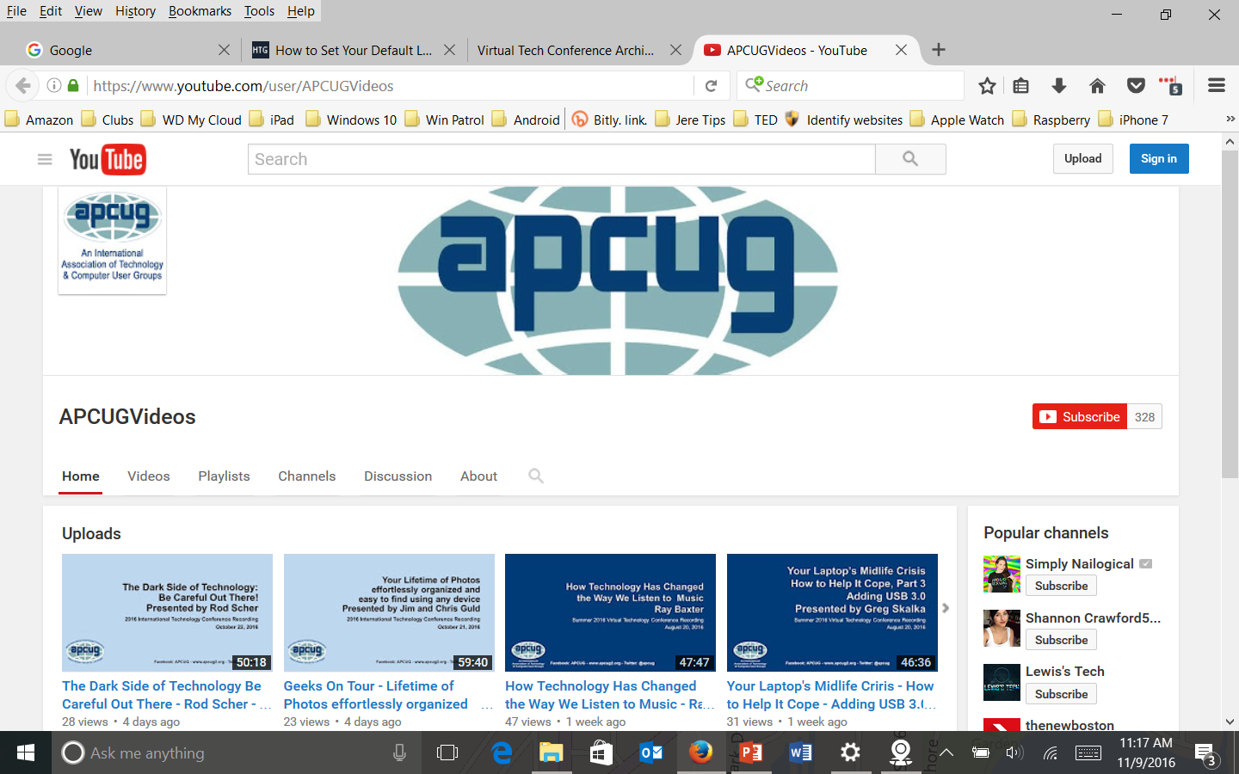
www.youtube.com/apcugvideos
A Great Place to find a presentation for a User Group Meeting.

Slide 8
What makes up the APCUG Organization?
7 Volunteers on the Board of Directors.
7 Volunteers on the Board of Advisors.
Meetings once a month on the Internet via ‘Zoom’.
Lots of emails and work behind the scenes.
Jere Minich
jminich@apcug.org
Region 5- FL, GA, LA, SC

